Slide 1
Semantic Segmentation

Slide 2
The Task
person
grass
trees
motorbike
road

Slide 3
Things vs Stuff
THINGS
Person, cat, horse, etc
Constrained shape
Individual instances with separate identity
May need to look at objects
STUFF
Road, grass, sky etc
Amorphous, no shape
No notion of instances
Can be done at pixel level
“texture”

Slide 4
How do you evaluate?
Pixel classification!
Accuracy?
Heavily unbalanced
Per-class accuracy
Average across classes and images

Slide 5
Challenges in data collection
Precise localization is hard to annotate
Annotating every pixel leads to heavy tails
Common solution: annotate few classes (often things), mark rest as “Other”
Common datasets: PASCAL VOC 2012 (~1500 images, 20 categories), COCO (~100k images, 20 categories)

Slide 6
Pre-convnet semantic segmentation
Things
Do object detection, then segment out detected objects
Stuff
”Texture classification”
Compute histograms of filter responses
Classify local image patches

Slide 7
Semantic segmentation using convolutional networks
w
3
h

Slide 8
Semantic segmentation using convolutional networks
c
w/4
h/4

Slide 9
Semantic segmentation using convolutional networks
c
w/4
h/4

Slide 10
Semantic segmentation using convolutional networks
c
w/4
h/4

Slide 11
Semantic segmentation using convolutional networks
c
#classes
Convolve with #classes 1x1 filters
w/4
h/4

Slide 12
Semantic segmentation using convolutional networks
Pass image through convolution and subsampling layers
Final convolution with #classes outputs
Get scores for subsampled image
Upsample back to original size

Slide 13
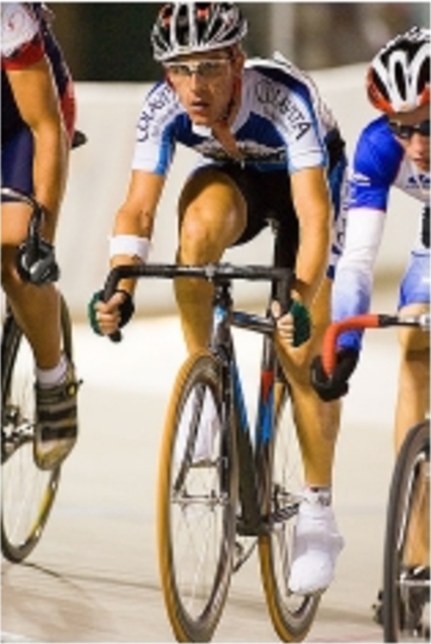
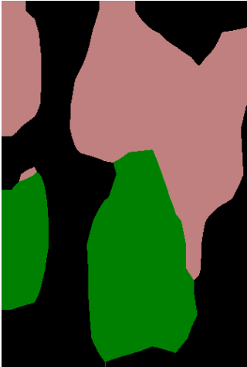
Semantic segmentation using convolutional networks
person
bicycle

Slide 14
The resolution issue
Problem: Need fine details!
Shallower network / earlier layers?
Not very semantic!
Remove subsampling?
Looks at only a small window!

Slide 15
Solution 1: Image pyramids
Higher resolution Less context
Learning Hierarchical Features for Scene Labeling. Clement Farabet, Camille Couprie, Laurent Najman, Yann LeCun. In TPAMI, 2013.

Slide 16
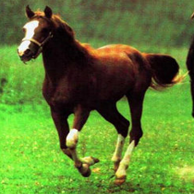
Solution 2: Skip connections
upsample

Slide 17
Solution 2: Skip connections

Slide 18
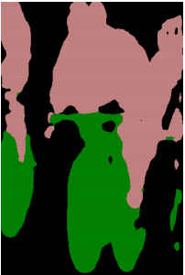
Skip connections
Fully convolutional networks for semantic segmentation. Evan Shelhamer, Jon Long, Trevor Darrell. In CVPR 2015

Slide 19
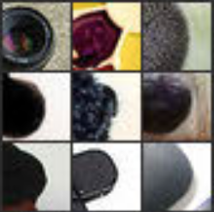
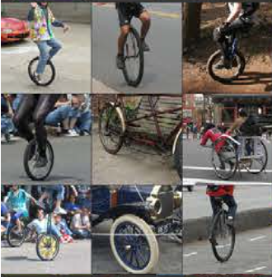
Skip connections
Problem: early layers not semantic
Horse
Visualizations from : M. Zeiler and R. Fergus. Visualizing and Understanding Convolutional Networks. In ECCV 2014.
Notes:
If you look at what one of these higher layers is detecting, here I am showing the input image patches that are highly scored by one of the units. This particular layer really likes bicycle wheels, so if this unit fires, you know that there is a bicycle wheel in the image. Unfortunately, you don’t know where the bicycle wheel is, because this unit doesn’t care where the bicycle wheel appears, or at what orientation or what scale.

Slide 20
Solution 3: Dilation
Need subsampling to allow convolutional layers to capture large regions with small filters
Can we do this without subsampling?

Slide 21
Solution 3: Dilation
Need subsampling to allow convolutional layers to capture large regions with small filters
Can we do this without subsampling?

Slide 22
Solution 3: Dilation
Need subsampling to allow convolutional layers to capture large regions with small filters
Can we do this without subsampling?

Slide 23
Solution 3: Dilation
Instead of subsampling by factor of 2: dilate by factor of 2
Dilation can be seen as:
Using a much larger filter, but with most entries set to 0
Taking a small filter and “exploding”/ “dilating” it
Not panacea: without subsampling, feature maps are much larger: memory issues

Slide 24
Solution 4: Conditional Random Fields
Idea: take convolutional network prediction and sharpen using classic techniques
Conditional Random Field

Slide 25
Fully Connected CRFs
Typically, only adjacent pixels connected
Fewer connections => Easier to optimize
Dense connectivity: every pixel connected to everything else
Intractable to optimize except if pairwise potential takes specific form
Efficient Inference in Fully Connected CRFs with Gaussian Edge Potentials. Philipp Krahenbuhl, Vladlen Koltun. In NIPS, 2011.

Slide 26
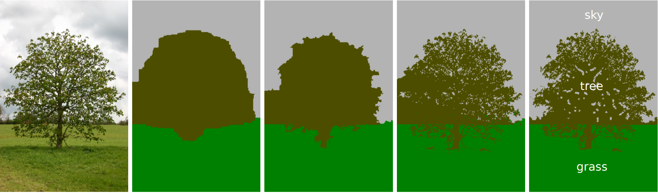
Fully Connected CRFs
Grid CRF
Fully connected CRF
Ground truth

Slide 27
Putting it all together
Best Non-CNN approach: ~46.4%
Semantic Image Segmentation with Deep Convolutional Nets and Fully Connected CRFs. Liang-Chieh Chen, George Papandreou, Iasonas Kokkinos, Kevin Murphy, Alan Yuille. In ICLR, 2015.

Slide 28
Other additions
Method | mean IoU (%)
VGG16 + Skip + Dilation | 65.8
ResNet101 | 68.7
ResNet101 + Pyramid | 71.3
ResNet101 + Pyramid + COCO | 74.9
DeepLab: Semantic Image Segmentation with Deep Convolutional Nets, Atrous Convolution, and Fully Connected CRFs. Liang-Chieh Chen, George Papandreou, Iasonas Kokkinos, Kevin Murphy, Alan Yuille. Arxiv 2016.

Slide 29
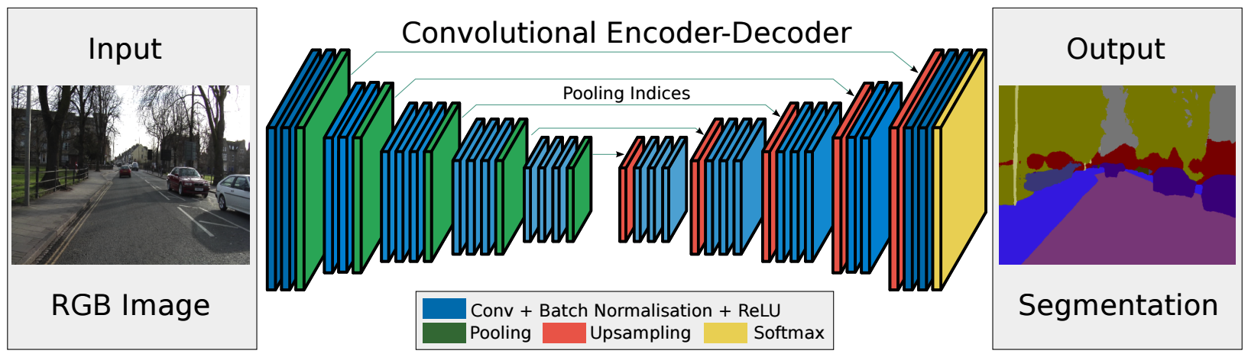
SegNet: Architecture

Slide 30
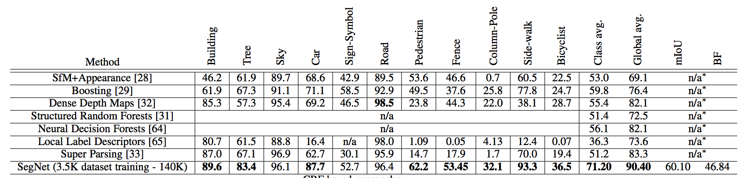
SegNet Evaluation
CamVid road scenes dataset
11 classes: building, tree, sky, car, sign, road, pedestrian, fence, pole, sidewalk, bicyclist

Slide 31
SegNet Video
https://www.youtube.com/watch?v=e9bHTlYFwhg

Slide 32
Image-to-image translation problems
Segmentation
Optical flow estimation
Depth estimation
Normal estimation
Boundary detection
…

Slide 33
Image-to-image translation problems

